Slide 1
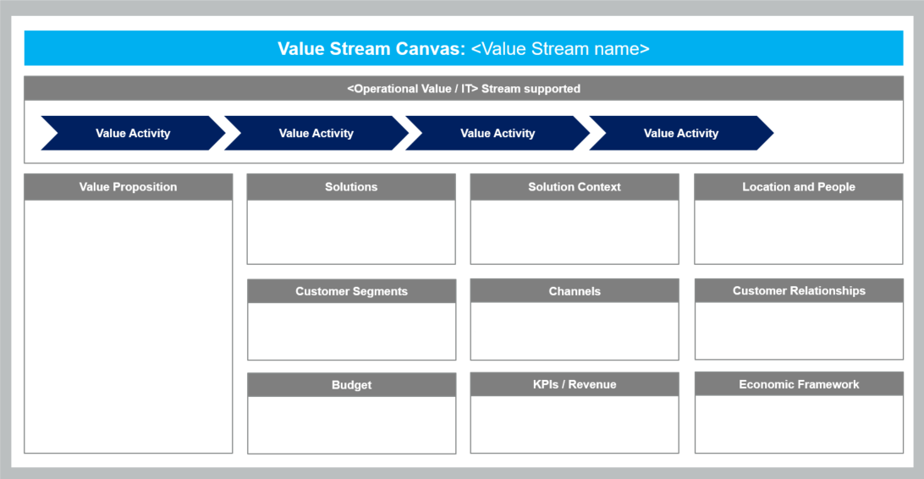
Value Stream Canvas Introduction
A Value Stream Canvas is a simple tool that stakeholders can use to capture their emerging understanding of the solution.
1. Value Stream
Value Streams represent the series of steps that an organization uses to implement Solutions that provide a continuous flow of value to a customer.
2. Type of Value Stream
Specify of Operational (customer facing) or IT (supporting)
3. Value Activities
Process steps supported in Value Stream
4. Value Proposition
FOR …
…
OUR SOLUTION …
7. Solution Context
Context which solution will operate for each customer segment
5. Solution
Systems, products or services developed
9. Location and People
Estimated number of people, by geography, in the operational/IT value stream
10. Customer Relationships
Type of relationship each customer segment expects the business to establish and maintain
6. Customer Segments
Customer segments served
8. Channels
Paths used to reach segment
13. Economic Framework
Set of decision rules that align everyone to the financial objectives of the solution
11. Budget
Budget for people and resources; allocated to the value stream; includes OpEx and CapEx
12. KPIs / Revenue
Key performance indicators for measuring value delivery

Slide 2
Value Stream Canvas: <Value Stream name>
<Operational Value / IT> Stream supported
Value Activity
Value Activity
Value Activity
Value Activity
Value Proposition
Solutions
Solution Context
Location and People
FOR [target customer segments(s)]
WHO [statement of the need or opportunity]
THE [solution name]
IS [a solution category]
THAT [key benefit, compelling reason to buy or use]
UNLIKE [primary competitive alternative, current system, or current business process]
OUR SOLUTION [statement of the primary
differentiation and advantages of new solution]
System, product or service developed
<segment> : Context which solution will operate
<location name> : <#> people
Customer Segments
Channels
Customer Relationships
Customer Segment served
<segment> : Path used to reach segment
<segment> : type of relationship
Budget
KPIs / Revenue
Economic Framework
Cap : $0
Exp : $0
Enter target for KPI or Revenue
Decision rules to align everyone to the financial objectives of the solution

